Slide 1
Alumni self-guided campus tour
Welcome back to the Colchester campus

Slide 2
Before we begin…
Make sure you have downloaded this file rather than view only. You’ll miss out on pictures!

Slide 3
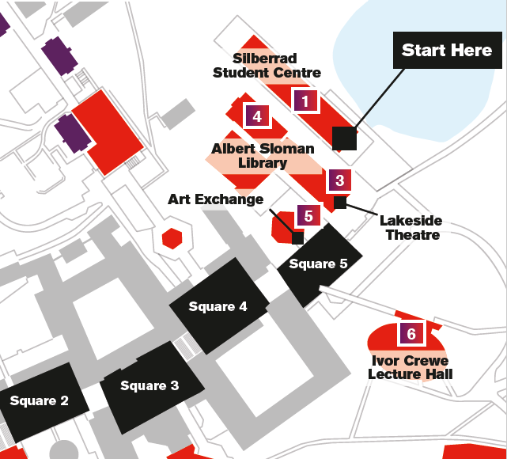
Start at the
Silberrad Student
Centre

Slide 4
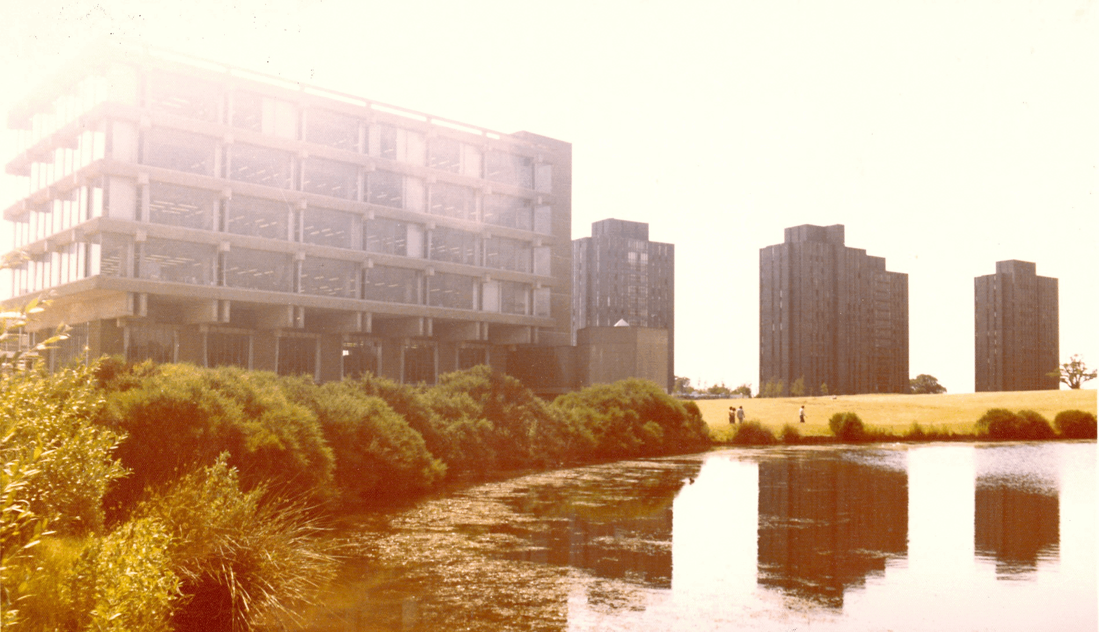
Silberrad Student Centre
Opened in 2015 and was built at the same time as the library extension.
Named in recognition of a landmark gift to the university.
Includes 24/7 access for students to computers and study pods, meeting rooms, a state-of-the-art media centre for the Students’ Union and a one-stop shop for students needing help with accommodation, payments, registration and wellbeing.

Slide 5
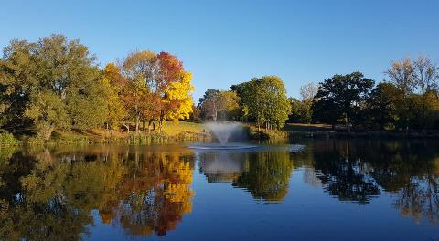
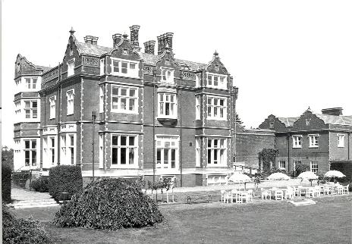
The lakes
A community area popular with students, staff and the general public.
Barbeques and picnic benches surround the biggest lake.
Follow the bottom path to the left around the lake for a 5-minute circular walk, you’ll finish at the Silberrad Student Centre.
Wivenhoe House
Located at the top of the hill.
The original home of the University of Essex, now a four-star hotel and home of the Edge Hotel School where hospitality students learn and work.
Alumni can get 15% off stays and a complimentary room upgrade.*
*more information at essex.ac.uk/alumni/membership

Slide 6
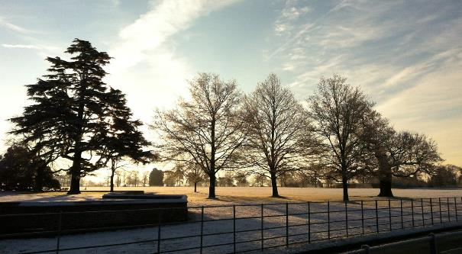
Wivenhoe Park
Winner of a Green Flag Award for 8 years running and the only university to achieve this.
Spans over 220 acres and has 18 major habitats with many notable species among its 2,800 trees.
Our three artificial lakes provide homes for carp, cormorants, and kingfishers, while 220 acres of grounds support much more fauna, flora, and fungi.
Home to an allotment and beehives, where students and staff can volunteer.
A guided tree walk is available.

Slide 7
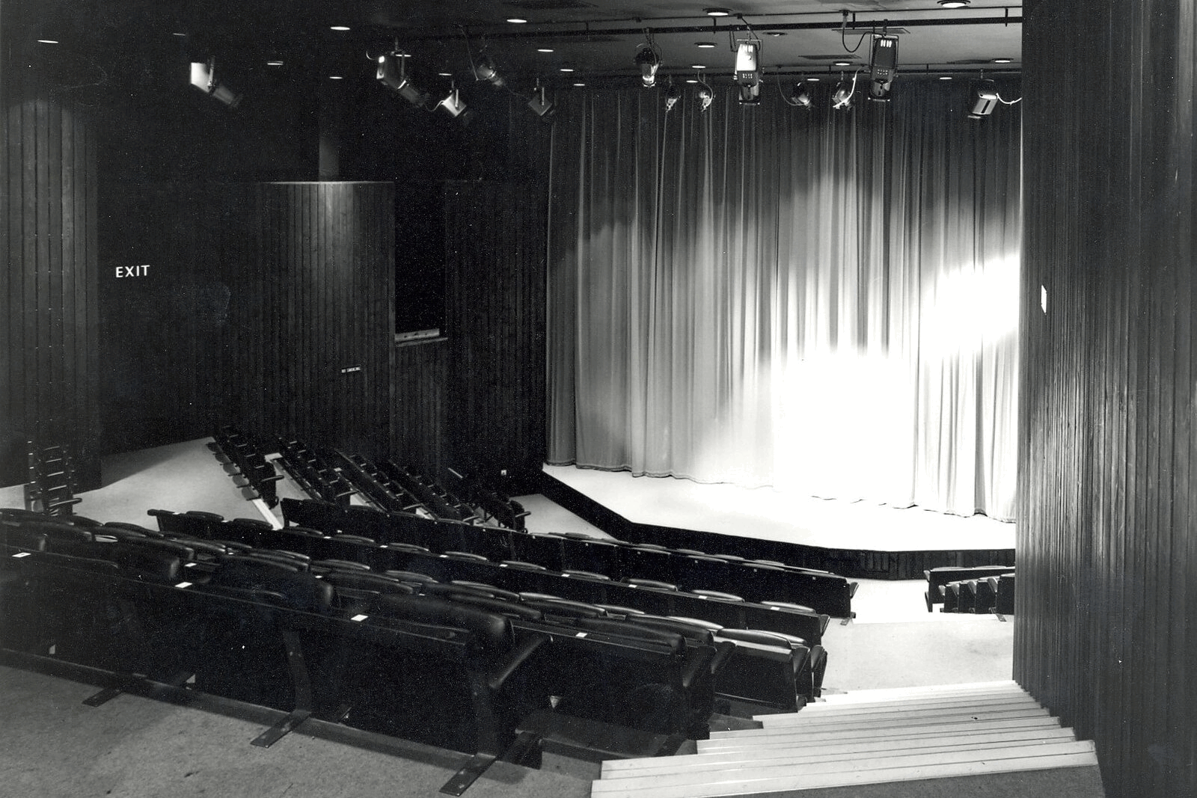
Lakeside theatre and café
A 200-seat underground theatre.
Showcases both student and professional productions, including live screenings from the National Theatre and weekly open-mic nights.
Alumni receive access a special concessionary rate for shows.

Slide 8
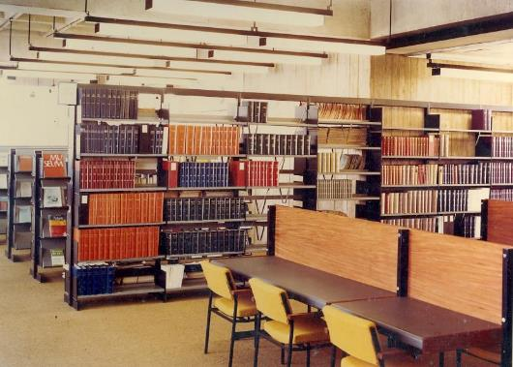
Albert Sloman Library
Named after the University’s first Vice-Chancellor
Extended in 2015 and now houses a collection of 1.4 million books and our special collections
Open 24/7 during term time
Now operates an automated external book return on the side of the building for late night runs
Home to our University archive and special collections
Most famous for its paternoster lift, one of just two in the UK

Slide 9
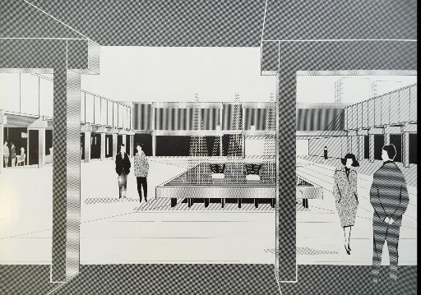
Art Exchange
Exhibits international contemporary art by established and emerging artists, ranging from painting, photography, film, sculpture and installations.
Offers free talks, workshops and events that support exhibition themes and explore wider topics

Slide 10
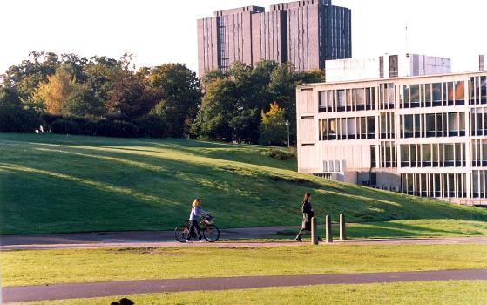
Ivor Crewe Lecture Hall
Built in 2006 and named after a past Vice-Chancellor.
One of the largest lecture theatres in the UK.
Seats 1,000 and is predominantly used for large lectures and events such as welcome week and graduation.
King Charles III called the steel-clad building a “dustbin” when he visited in 2008, it won a Civic Trust Award the same year.

Slide 11
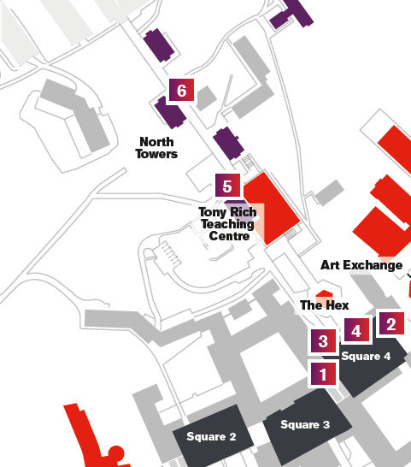
Head to Square 4
Home to Top Bar, the SU stores and Buffalo Joes
Now head under the archway towards the Hex
Please note, the next section of the tour involves
covering a long distance and multi-levels, all of which can be accessed by lift

Slide 12
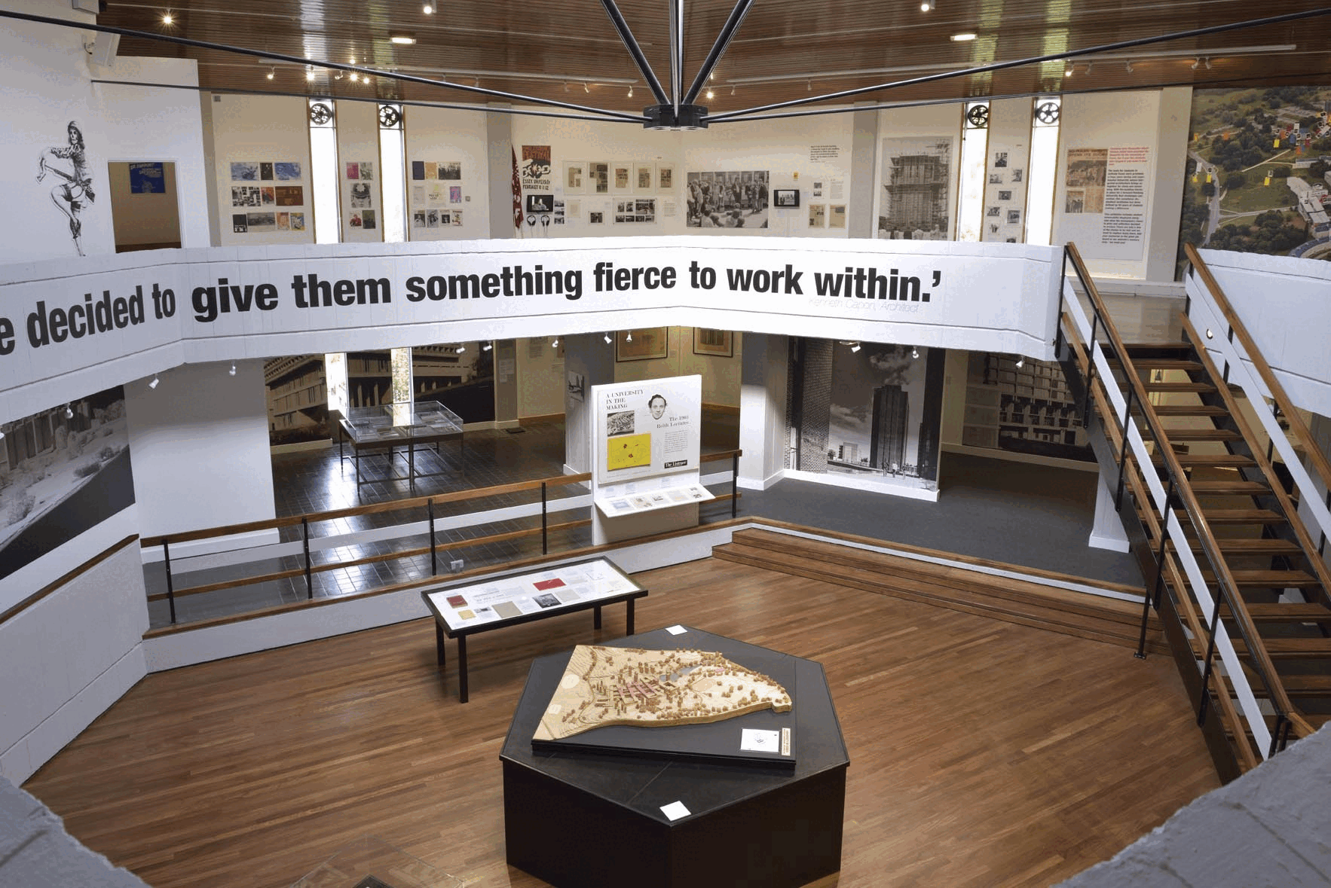
The Hex
Currently used as a lecture space, but has also been used as an arts space and an exhibition for the 50th anniversary.
Used to be a restaurant, with lots of alumni telling us how famous the omelettes were in the 80s!
Held many gigs in the University’s earlier years.
The launderette underneath was a social hub through the years, with many alumni meeting their future spouses here.

Slide 13
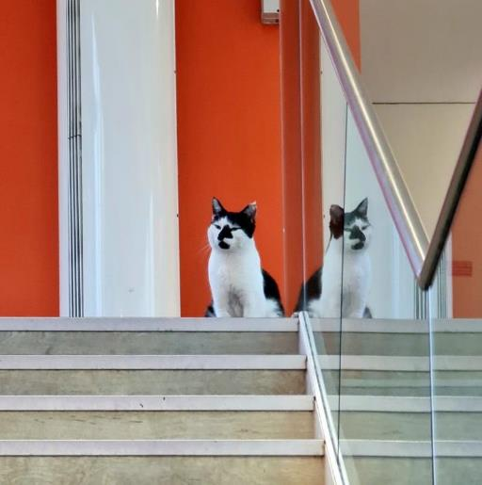
Tony Rich Teaching Centre
The glass-fronted teaching centre was built in 2010 to provide additional lecture space for the growing student population.
Named after the University’s Registrar and Secretary at the time.
It makes clever use of previously redundant space – it used to be the University’s central boiler house and is situated 85 per cent underground.
You’ll usually find campus cat sunning himself here!

Slide 14
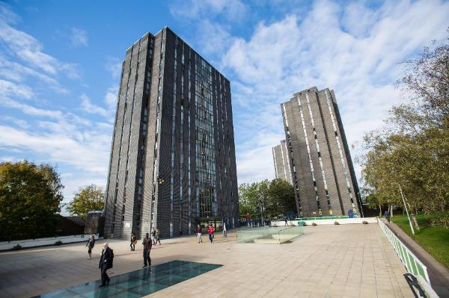
The North Towers
Work began on the first tower, Rayleigh, in 1964.
These towers are nearly all now closed for refurbishment.
Nightline, the voluntary service providing confidential listening, emotional support, information and supplies, is still running out of Keynes tower.
Nestled between the towers are two new teaching centres to host seminars and small classes.

Slide 15
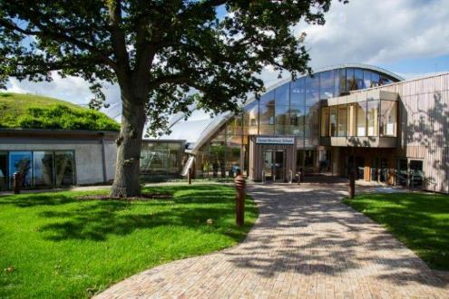
Essex Business School
The largest department at the university.
A zero-carbon building and the first of its kind on a UK university campus.
Home to seminar rooms, lecture halls, study pods and a virtual Bloomberg trading floor.
Inside is a winter garden with a domed roof at the heart of the site creating its own micro-climate. Feel free to head inside to have a look.

Slide 16
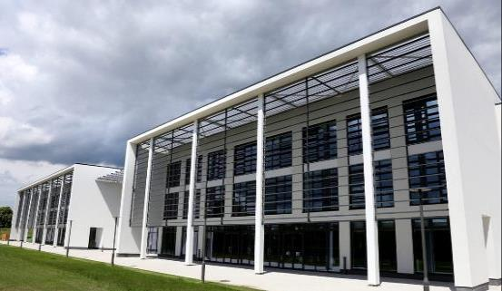
Knowledge Gateway (closed to the public at the weekend)
Developed to become the location of choice in the eastern region for knowledge-based enterprises in science, technology and the creative sector.
Parkside Office Village provides a home to many local SMEs.
The Innovation Centre provides additional space with hands-on support to help start-ups and small businesses scale up and succeed. It’s also home to a state-of-the-art creative digital studio, Studio X, used by our Essex Startups team who support students and recent graduates.

Slide 17
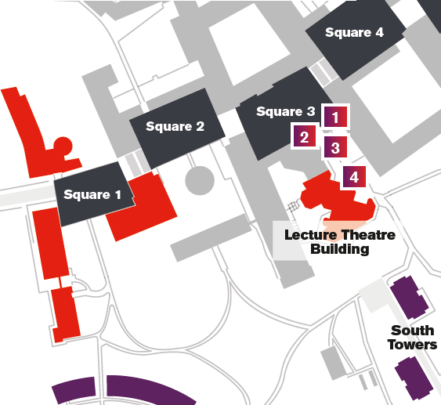
Back to Square 3
The heart of campus
Home to the Students’ Union

Slide 18
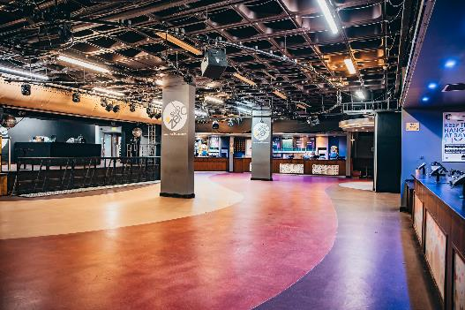
The Students’ Union
Square 3 is the hub of SU facilities
On Thursdays, local food stalls descend to the square for market day
Sub Zero is the University’s underground nightclub
The SU bar opens at 4pm today – not long to wait!
Between Squares 3 and 2, you’ll find a new ‘Wall of Fame’ listing all previous Students’ Union officers – let a member of the Alumni Relations team know if your name is missing!

Slide 19
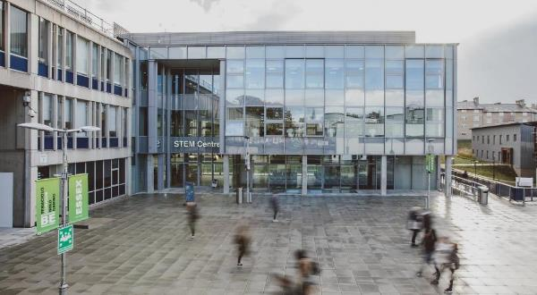
Square 1
This area is home to the School of Mathematics, Statistics and Actuarial Science, Department of Psychology and School of Computer Science and Electronic Engineering.
On the left you’ll see the £18m STEM centre which opened in 2018.
The STEM centre includes a life sciences wet lab with digital microscopes, computer labs as well as teaching space.

Slide 20
Back to Square 3
Head back up the stairs, towards Square 3 and turn right towards the Lecture Theatre Building

Slide 21
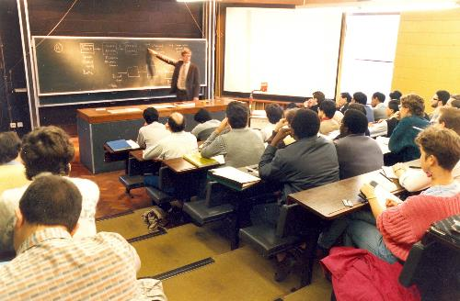
Lecture Theatre Building (LTB)
In addition to lectures and classes, the building used to host graduation ceremonies.
Film Soc (known for their all-nighters in the 80s and 90s) were regular users of the space, shows such as Mastermind were filmed here and many concerts held.
It now holds lectures and exams, and a cinema run by the SU, Cine 10.
Graduates also come here to get gowned up ahead of graduation ceremonies that now take place in Ivor Crewe Lecture Hall.

Slide 22
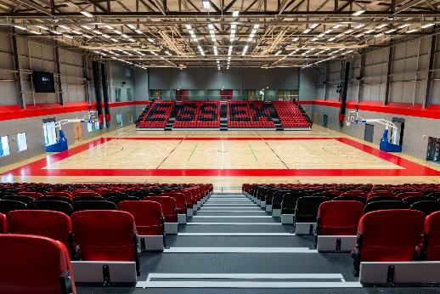
Sport at Essex
Up the hill, over £10m has been invested in new sports facilities providing access to indoor and outdoor pitches, covered all weather tennis courts, sports hall, squash courts, a climbing wall and gym.
Elite performance sports include Basketball, Football, Volleyball, Tennis and Rugby 7s.
Essex is now one of the UK’s top 30 sporting universities (in the British Universities and Colleges Sport rankings) for the first time in our 60-year history.
We’re also proud to be a Women’s High Performance Football Centre in partnership with the FA.

Slide 23
We hope you enjoyed your self-guided tour.
To head back to the Silberrad Student Centre/Reception, walk along the path past the top of the Ivor Crewe Lecture Hall and follow the path down the hill.
Stay in touch:
essex.ac.uk/alumni
alumni@essex.ac.uk
Instagram, LinkedIn, Facebook, X

